Slide 1
Dibimbing Data Engineering Project
RFM Segmentation - Batch Processing
Muhamad Ivan
Data Engineering Batch V

Slide 2



Education:
Universitas Trisakti
Master Management Marketing (2021-2023)
Hacktiv8
Bootcamp Data Scientist batch 13 (2014-2019)
Muhamad Ivan
Institut Tekonologi Bandung
Environmental Engineering (2014-2019)
Self Overview:
Data analyst worked at Fintech with 2 years of experience in interpreting data in growing start up, and providing suggestion to boost business revenues in financial technology companies in Indonesia.
Working Experience:
Data Analyst
at Transfez (2022-present)
LinkedIn:
https://www.linkedin.com/in/mivanivan/
HSE Staff
PT Seiwa Indonesia (2019-2022)

Slide 3
Overview Project
Transfez Analysis:
Discovering consumer transaction behavior towards seasonal patterns and destination country currencies so that marketing can anticipate low season transactions and take advantage of consumer behavior during high seasons.
Create an analysis of consumer alive probability for each of the consumer. This analysis can help CRM to identify potential churn customers so that preventive measures can be taken
Determine which customers to target for marketing campaigns using techniques like RFM analysis (scoring, segmentation, predictive model).
Discovering AHA Moment in consumer product in order to improve user retention.
Hacktiv8 Project:
Handwritten Signature Forgery Detection using Computer Vision & Cosine Similarity
Gender Prediction based on close-up photos Using Convolutional Neural Network (CNN) / Computer Vision

Slide 4
Main Project

Slide 5
Project Background
RFM itself is a fairly well-known and frequent analysis method used in marketing strategies through a CRM (Customer Relationship Management) approach. RFM requires loyalty assessment not only to be seen from the amount of purchase value (monetary) carried out by the customer but also involves the level of frequency and last time (recency) a customer makes a transaction.
To maintain the quality of segmentation, maintenance needs to be carried out regularly and it is quite labor intensive if done manually and high change of human error.

Slide 6
Objective & Benefits
Objective:
Create a pipeline that can automate the segmentation process periodically
Benefits:
This pipeline will reduce human effort which has to be done manually and eliminate human error
This pipeline will help data analyst and product manager to decide which user get promotion to maintain users retention.

Slide 7
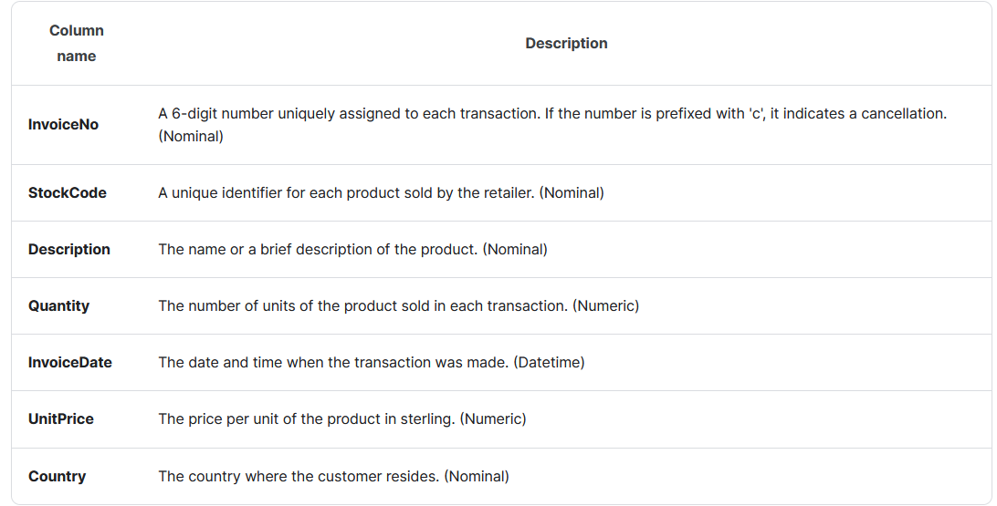
Data Understanding
Source Data: Online Retail Transaction Data (Link: Kaggle)
Data Credit:
Total Column : 7 Column
Total Row : 541,909 Row
Data Description: UK Online Retail Sales and Customer Transaction Data

Slide 8






Expected Architecture / Pipeline
Workload Orchestrator
Input Data
Processing & Transform
Data Source
Data Output

Slide 9
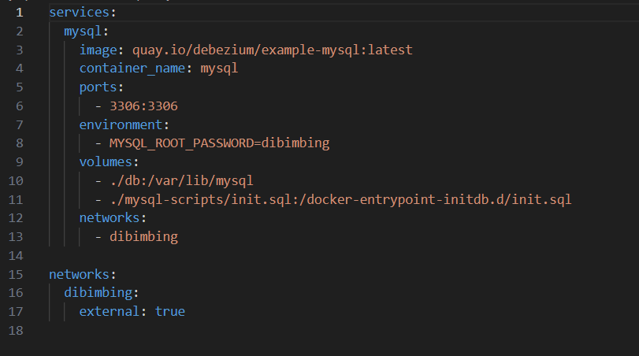
Data Pipeline – Data Source
MySQL: docker-compose.yaml

Slide 10
Data Pipeline - Processing
Airflow DAG:
File:
2_final_assignment.py
Step:
Define Airflow DAG named etl_mysql_to_mysql_2
Extract: take data from MySQL into xcom
install_dependencies: Installing necessary package such as scikit-learn
transform_data: processing data from raw data into users segmentation
load_to_mysql: load the data back to MySQL

Slide 11
Data Pipeline - Processing
from airflow.decorators import dag
from airflow.operators.empty import EmptyOperator
from airflow.providers.mysql.operators.mysql import MySqlOperator
from airflow.operators.python import PythonOperator
from airflow.utils.dates import days_ago
from airflow.hooks.base import BaseHook
import pandas as pd
import sqlalchemy
import subprocess
import numpy as np
@dag(start_date=days_ago(1), schedule_interval=None, catchup=False)
def etl_mysql_to_mysql_2():
start_task = EmptyOperator(task_id="start_task")
end_task = EmptyOperator(task_id="end_task")
extract = MySqlOperator(
task_id="extract_from_mysql",
mysql_conn_id="mysql_default",
sql="SELECT * FROM final_assignment.online_retail",
do_xcom_push=True
)
Import Package
Defining DAG
Extracting table online_retail from mysql Database
def install_dependencies():
subprocess.check_call(['pip', 'install', 'scikit-learn', 'pymysql'])
install_dependencies_task = PythonOperator(
task_id='install_dependencies',
python_callable=install_dependencies
)
Install scikit-learn & pymsql

Slide 12
Data Pipeline - Processing
def transform_data(ti):
from sklearn.preprocessing import StandardScaler
from sklearn.cluster import KMeans
extracted_data = ti.xcom_pull(task_ids='extract_from_mysql')
columns = ['index', 'InvoiceNo', 'StockCode', 'Description', 'Quantity', 'InvoiceDate', 'UnitPrice', 'CustomerID', 'Country']
df = pd.DataFrame(extracted_data, columns=columns)
df['Quantity'] = abs(df['Quantity'])
df = df[df['UnitPrice'] > 0]
df['InvoiceDate'] = pd.to_datetime(df['InvoiceDate'])
df['month_index'] = df['InvoiceDate'].dt.month * 0.01 + df['InvoiceDate'].dt.year
df['revenue'] = df['UnitPrice'] * df['Quantity']
result = df.groupby(['CustomerID']).agg(
first_transactions=pd.NamedAgg(column='InvoiceDate', aggfunc='min'),
last_transactions=pd.NamedAgg(column='InvoiceDate', aggfunc='max'),
Total_revenue=pd.NamedAgg(column='revenue', aggfunc='sum'),
Number_Transactions=pd.NamedAgg(column='CustomerID', aggfunc='count'),
nunique_month_index=pd.NamedAgg(column='month_index', aggfunc=pd.Series.nunique)
).reset_index()
max_date = df['InvoiceDate'].max()
result['first-last'] =(result['last_transactions'].dt.month + result['last_transactions'].dt.year *12 ) - (result['first_transactions'].dt.month + result['first_transactions'].dt.year * 12) + 1
result['User Age'] =(max_date.month + max_date.year *12 ) - (result['first_transactions'].dt.month + result['first_transactions'].dt.year * 12) + 1
result['recency'] = result['User Age'] - result['first-last'] + 1
result['Recency-Log'] = np.log(result['recency'])
result['Monetary-Log'] = np.log(result['Total_revenue'])
result['Frequency-Log'] = np.log(result['Number_Transactions'])
max_GTV = max(result['Monetary-Log'])
min_GTV = min(result['Monetary-Log'])
max_TRX = max(result['Frequency-Log'])
min_TRX = min(result['Frequency-Log'])
min_recency = min(result['Recency-Log'])
max_recency = max(result['Recency-Log'])
result['Recency_Score-Log'] = 5 * (result['Recency-Log'] - min_recency) / (max_recency - min_recency)
result['Frequency_Score-Log'] = 5 * (result['Frequency-Log'] - min_TRX) / (max_TRX - min_TRX)
result['Monetary_Score-Log'] = 5 * (result['Monetary-Log'] - min_GTV) / (max_GTV - min_GTV)
result_score = result[['Recency_Score-Log', 'Frequency_Score-Log', 'Monetary_Score-Log']]
Preprocessing data, cleaning, and normalization

Slide 13
Data Pipeline - Processing
scaler = StandardScaler()
df_scaled = scaler.fit_transform(result_score)
k = 4 # Set the number of clusters
kmeans = KMeans(n_clusters=k, random_state=42).fit(df_scaled)
result_score['cluster_label'] = kmeans.fit_predict(df_scaled)
def assign_cluster_label(label):
if label == 0:
return 'Sleep'
elif label == 1:
return 'Potential'
elif label == 2:
return 'Champion'
elif label == 3:
return 'Lost' result_score['cluster_label_new'] = result_score['cluster_label'].apply(assign_cluster_label)
df_final = pd.concat([result, result_score[['cluster_label', 'cluster_label_new']]], axis=1)
df_final = df_final[['CustomerID', 'Total_revenue', 'Number_Transactions', 'recency', 'cluster_label', 'cluster_label_new']]
ti.xcom_push(key='transformed_data', value=df_final.to_dict('records'))
transform = PythonOperator(
task_id='transform_data',
python_callable=transform_data
)
K-means Clustering
Cluster labelling
Creating Output Table and call transform_data

Slide 14
Data Pipeline - Processing
def load_to_mysql(ti):
# Pull the transformed data from XCom
transformed_data = ti.xcom_pull(task_ids='transform_data', key='transformed_data')
# Create a DataFrame from the transformed data
df = pd.DataFrame(transformed_data)
# Establish connection to the target MySQL database
mysql_conn = BaseHook.get_connection('mysql_default')
database_name = "final_assignment" # Replace with your actual database name
engine = sqlalchemy.create_engine(f'mysql+pymysql://{mysql_conn.login}:{mysql_conn.password}@{mysql_conn.host}:{mysql_conn.port}/{database_name}')
# Load the DataFrame into the target MySQL table
df.to_sql(name='rfm_segmentation', con=engine, if_exists='replace', index=False)
load = PythonOperator(
task_id='load_to_mysql',
python_callable=load_to_mysql
)
# Define the task dependencies
start_task >> extract >> install_dependencies_task >> transform >> load >> end_task
etl_dag = etl_mysql_to_mysql_2()
Load the table into Mysql Database
Define the tas dependencies

Slide 15
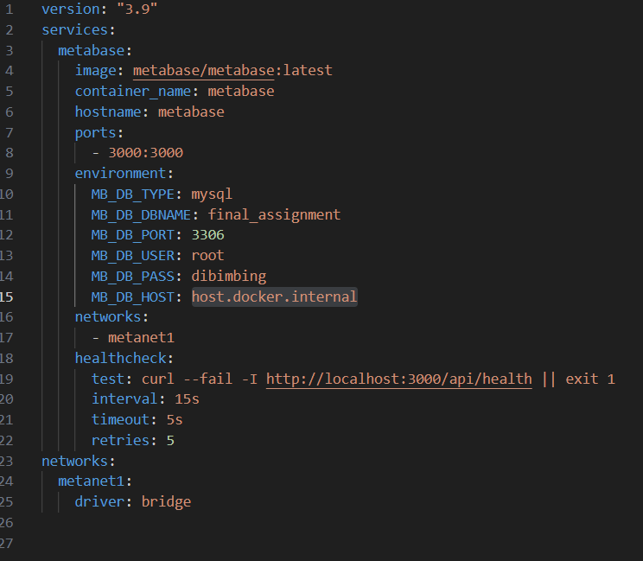
Data Pipeline - Visualization
Metabase: docker-compose.yaml

Slide 16
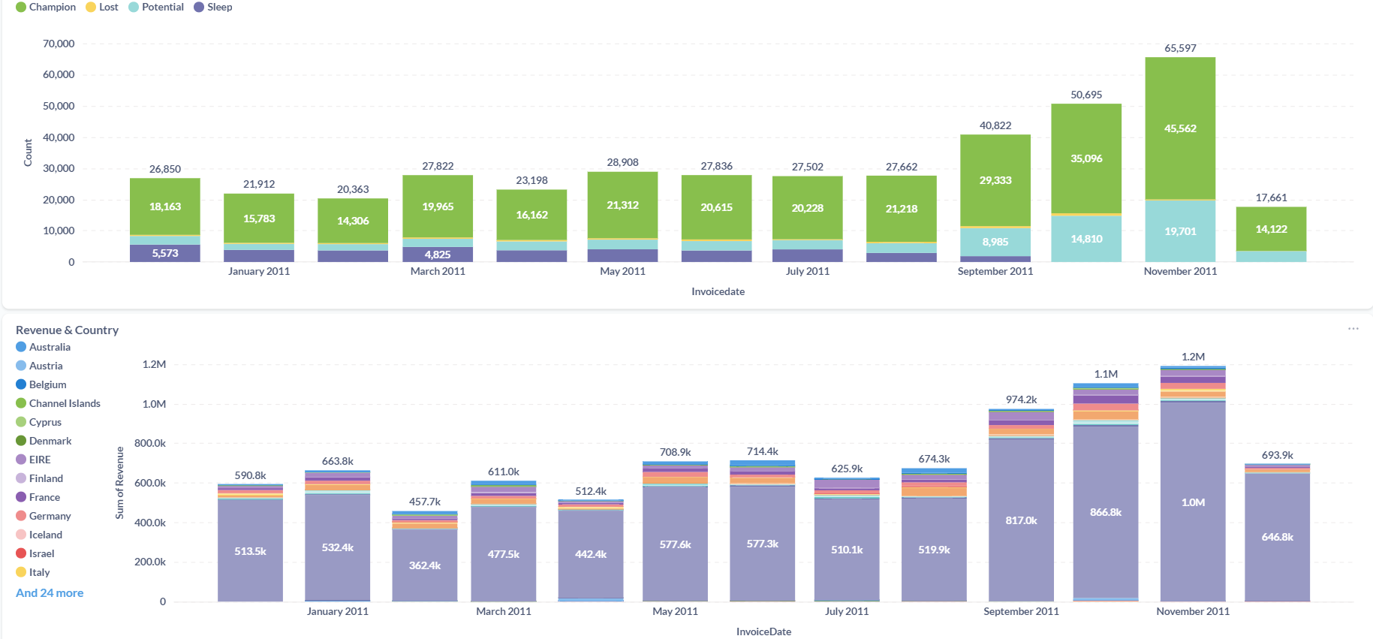
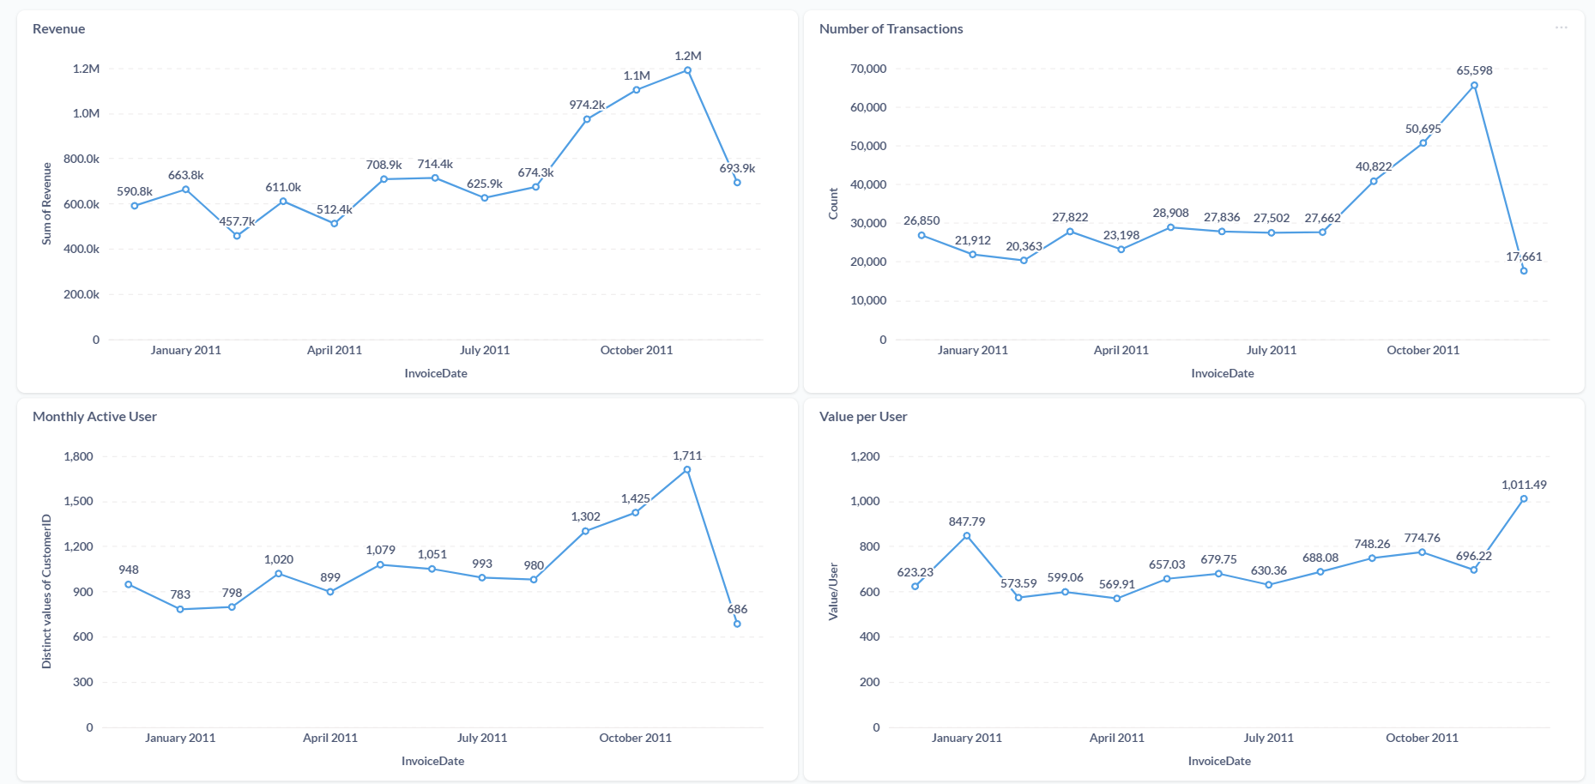
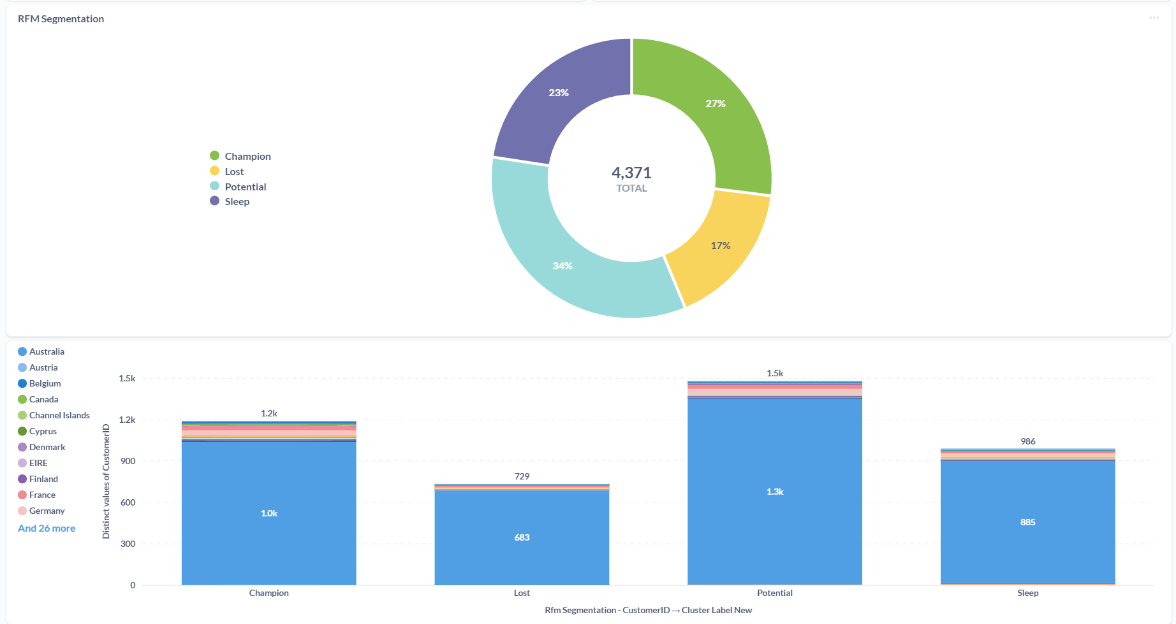
Data Output

Slide 17
Conclusion
The pipeline works fine and fully functional. It can update the RFM segmentation periodically
Limitation
The clustering label code not work perfectly as expected. If new data is added the result label is changing and mixed.
The code can’t make rfm_segmentation table automatically. So the table must be create manually so the code can work.
The pipeline not including OLTP Database and warehouse such as big query and google cloud which utilize external database.

Slide 18
Update
Clustering labeling has been improved so that even if there are additional transactions the cluster label will remain consistent
The transformation code has been separated so that the DAG code becomes shorter.
Eliminates the install stage by adding the installation in the Dockerfile

Slide 19
THANK YOU

